Slide 1
IOT MINI PROJECT
TITLE : SMART IRRIGATION
done by : Renish raja (20CSR169)
NAVANEETH S B (20CSR134)
PRAVEEN RAJ KUMAR (20CSL260)

Slide 2
PROBLEM STATEMENT
Nowadays, in farming, land residential areas are located in different places for people working in various jobs. So, maintaining the farming land is so difficult for them. Even for people who have both areas located in the same area, find it difficult to maintain. Our project helps to keep in check of the farming land whenever they want and can irrigate their land whenever they want, and irrespective of the place they are. They can make it possible through a connected internet. As this device will help to check the moisture content on the farming field, and if the water content is low, it will automatically sense and inlet the water out. If the water content reaches a certain limit, it stops the motor, and the process will be completed.

Slide 3
PROCEDURE/STEPS
The entire system made is connected to an AI chat system (telebot)
The moisture sensor senses the value in the soil and reads the moisture content in the soil.
If the read value is less than the threshold value, it signals the motor to start.
Else, the motor remains off.
In a manual state, the person can go to the respective fields and, if not satisfied with the moisture content, manually turn on the motor.
This can be done in the telebot chat system, which is connected through WiFi and controlled by the Arduino.
There is also a provision for a lamp along with this system, which the person can also use with the telebot and control via a mobile phone.

Slide 4
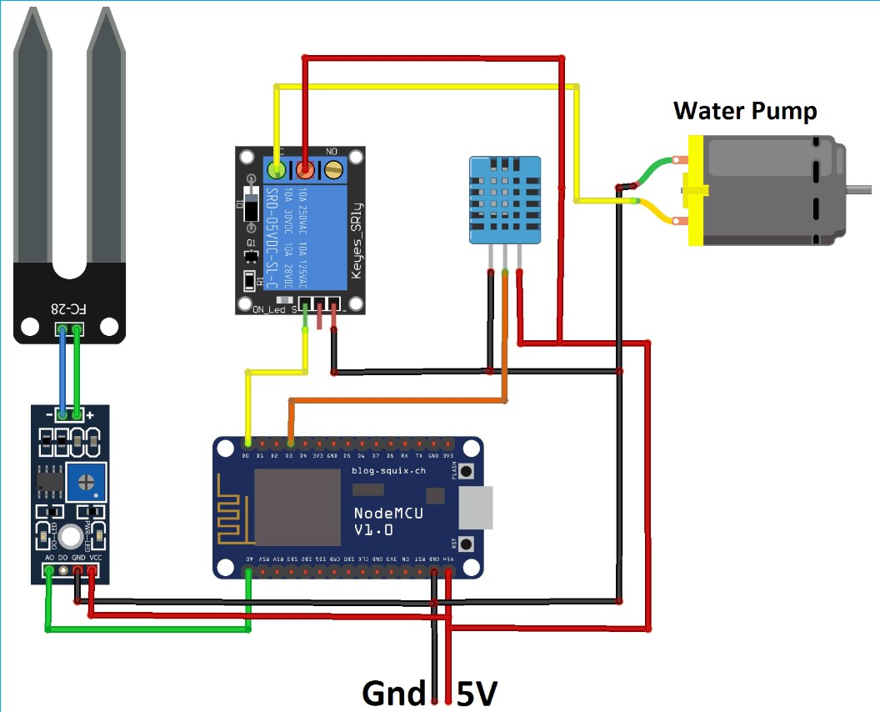

Slide 5
COMPONENTS REQUIRED:
Ardiuno esp8266
Relay 12v
Moisture Sensor
Water Pump
Led Light
Connecting Wires
Adapter 12v dc

Slide 6
Ardiuno esp8266:
The Arduino ESP8266 is a development board that can be used for creating Internet of Things (IoT) projects. It is based on the ESP8266 Wi-Fi module, which enables it to connect to the internet and communicate with other devices.
Working with Arduino ESP8266 involves setting up the hardware and software, programming the board, connecting it to Wi-Fi, and using it to interact with other devices and services on the internet. Once the ESP8266 is connected to the internet, it can communicate with other devices using various communication protocols such as HTTP, MQTT, and TCP/IP.
Overall, the Arduino ESP8266 is a versatile and popular platform for creating IoT projects due to its small size, ease of use, and ability to connect to the internet.

Slide 7
Relay 12V:
A relay is an electrical component that allows a low-power signal to control a high-power circuit. A 12V relay is designed to switch a 12V DC circuit on or off using a small control signal.
The working principle of a relay is simple. It consists of an electromagnet that, when energized by a control signal, pulls a switch to make or break a circuit. The relay can be normally open (NO), which means that the circuit is open until the relay is energized, or normally closed (NC), which means that the circuit is closed until the relay is energized.
A 12V relay is typically used in automotive, industrial, and home automation applications to control high-power devices such as motors, lights, and heaters. It can be controlled by a microcontroller or other low-power device using a small signal, such as a digital output pin.
Overall, a 12V relay is a useful component for controlling high-power circuits with a low-power control signal. It is widely used in a variety of applications and is available in various configurations to suit different needs.

Slide 8
Moisture Sensor:
A moisture sensor is an electronic device that measures the moisture content of a material. It is used in a variety of applications, including agriculture, construction, and environmental monitoring.
The working principle of a moisture sensor depends on the type of sensor used. One common type of sensor is a resistive sensor, which measures the electrical resistance of a material. As the moisture content of the material changes, its resistance changes, allowing the sensor to measure the moisture level.
Moisture sensors are commonly used in agriculture to monitor soil moisture levels and help optimize irrigation. They are also used in construction to ensure that building materials are dry before they are used, which helps prevent mold and other problems. Additionally, moisture sensors are used in environmental monitoring to measure the moisture content of air, soil, and other materials.
Overall, a moisture sensor is a useful tool for measuring the moisture content of a material. It is widely used in a variety of applications and is available in various configurations to suit different needs.

Slide 9
conclusion
Overall, this IOT-based Smart irrigation application would help eliminate the major problem for people in irrigating their agricultural farms. In the future, it can be supported with a drone automated system to provide more functions.

Slide 10
THANK YOU

